Slide 1
A project Presentation
COEN 6711- Microprocessors and their applications
Concordia university, fall- 2018

Slide 2
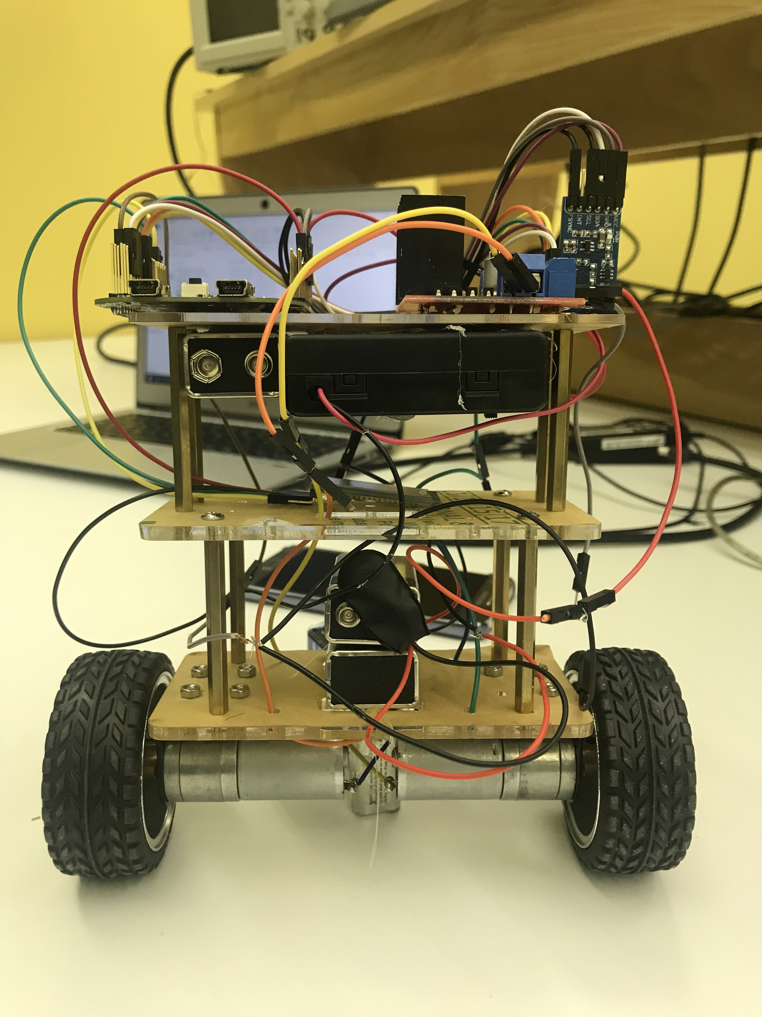
“A self balancing robot”
Team
Horia petre (26035035)
Md. Shafayet Sajid (40075368)
Diego Mayorga (40075927)

Slide 3
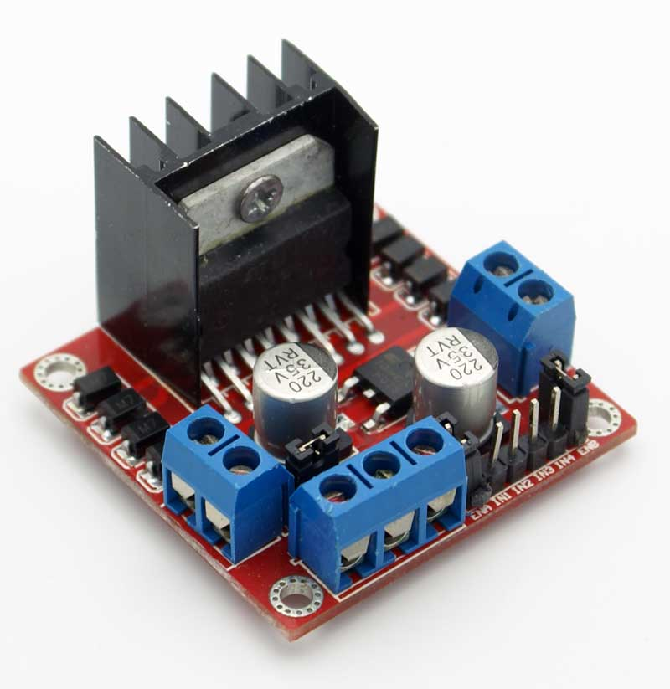
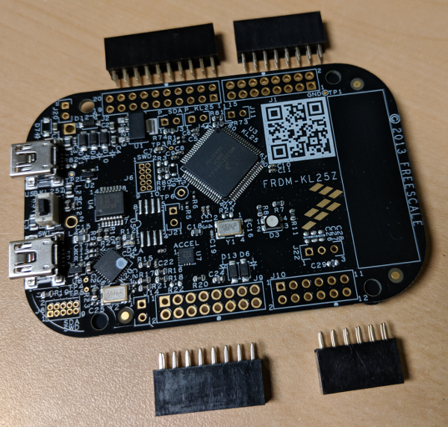
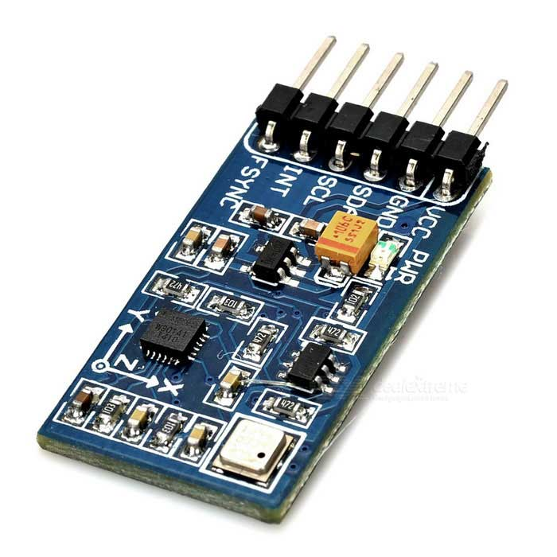
Main components
Microcontroller Board
Inertial Measurement Unit
Motor Drive Module

Slide 4
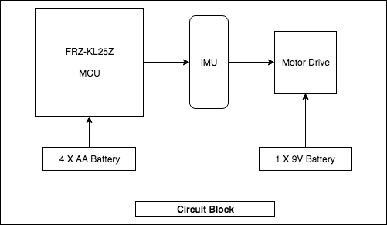
Circuit block

Slide 5
Control block diagram

Slide 6
Excited to see the result ??

Slide 7
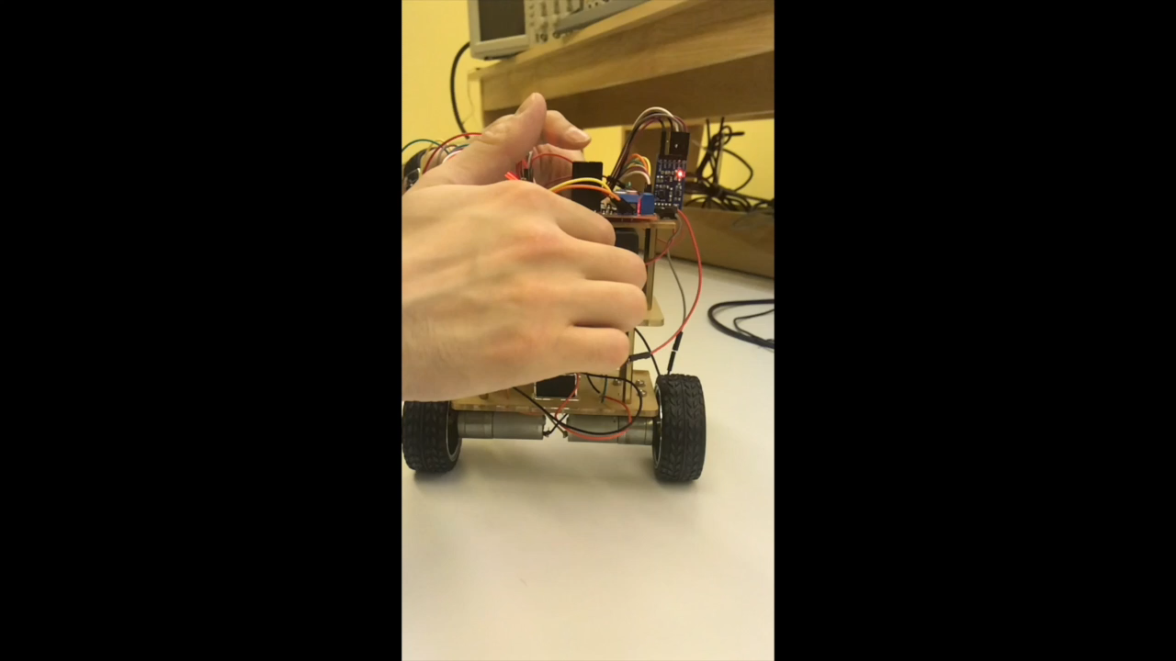

Slide 8
Bluetooth connection through mobile apps

Slide 9
Thank you

